Slide 1
Big Mart Sale Prediction

Slide 2
Objective: Development of prediction model for Big mart shop sale. It will help Big chain shop to identify product for their store and also where to open which store.
Benefits:
1.Prediction of sale
2.Identify product.
3.Identify shop type and location

Slide 3
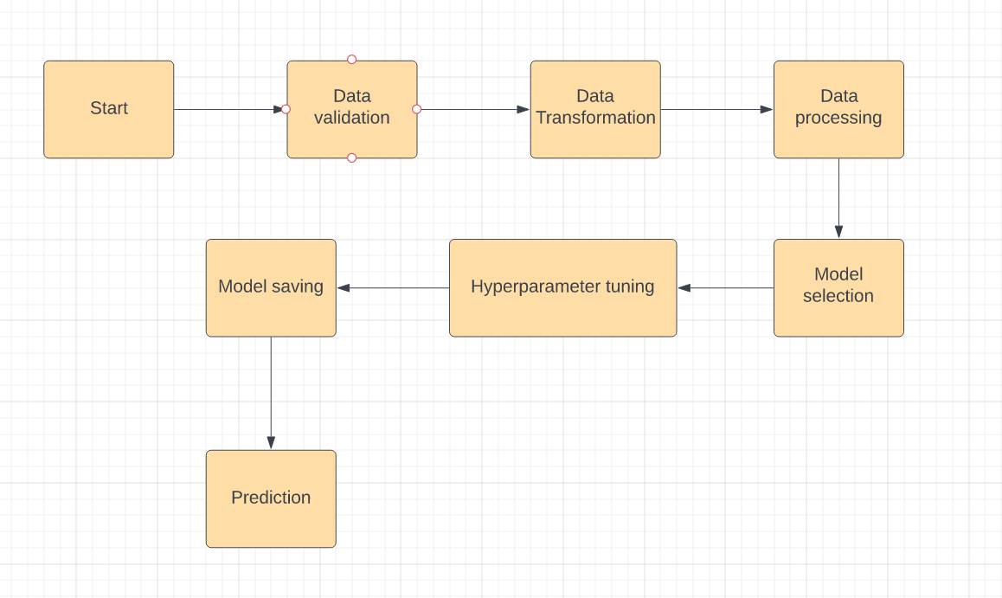
Architecture

Slide 4
Model Training Data preprocessing: Performing EDA to get insight of data like identifying distribution , outliers ,trend among data etc. Check for null values in the columns. If present impute the null values. Encode the categorical values with numeric values. Perform Standard Scalar to scale down the values.

Slide 5
Model seclection: After Eda we have use many Ml model such as Linear Regression, Xgboost, Random forest. Among them we find the best model Random forest.

